Slide 1
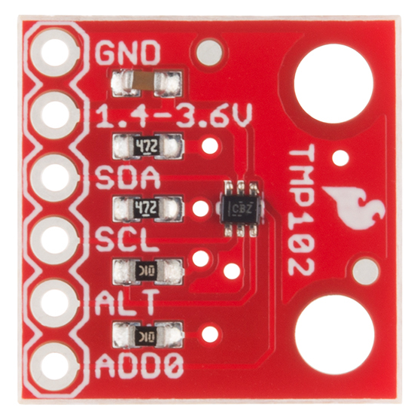
Tmp102 (Temperature sensor)

Slide 2
Proposal
The sensor will give temperature readings of the objects like battery and circuit board so that we can detect whether it is damaged or it can still work . Like it can be used to test the temperature for multiple objects in a particular device such as smart phone, laptop. Also for example it can be used to record the temperature readings of the device called drone .Which I along with my group members GURSEHAJ and ARMAN are planning to do in next semester .

Slide 3
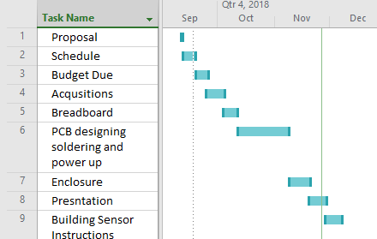
PROJECT SCHEDULE
Everything went properly as planned I was able to complete all the requirements for project in time.

Slide 4
BUDGET
TMP102 SENSOR :- $15.25
RASPBERRY PI :- $73.17
SD CARD :-$10.20
HEADER PINS GOT FROM PROTOTYPE LAB.
TOTAL EXPENSE :-$98.63

Slide 5
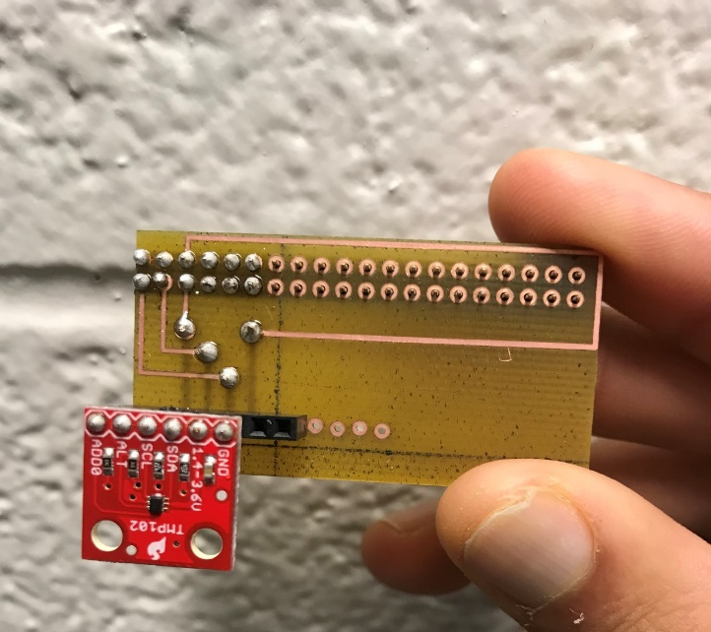
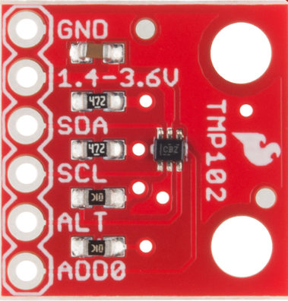
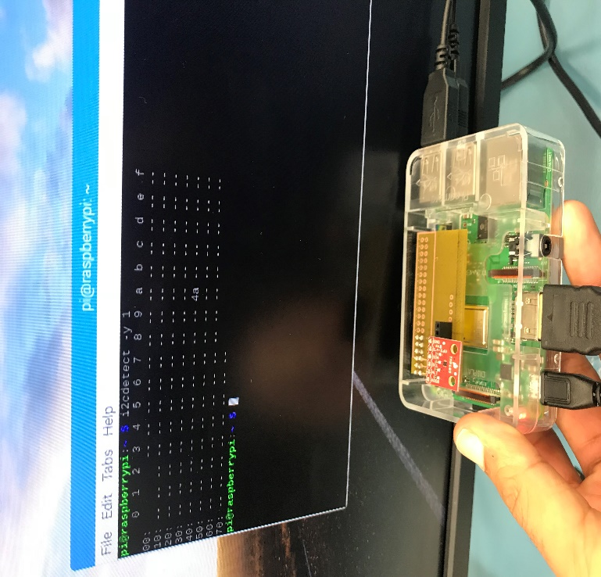
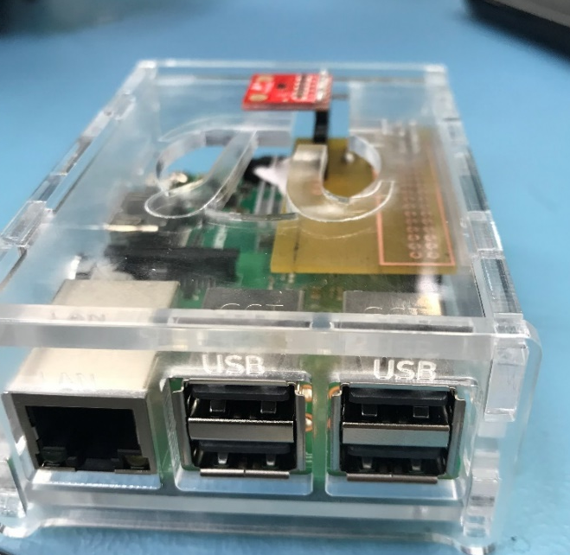
Soldering
Readings
Working
Enclosure

Slide 6
Knowledge From Previous Courses.
TECH 153 and CENG209 :- Learnt about the raspberry pi and its working.
TECH 101 and 150 :- Learnt about how to work with electronic circuits.
CENG 216:- Learnt about Gantt Project.
ESOL 120 and 220 :- Learnt about documentation, how to write reports and to email .

